Slide 1
.Net Programming
Ngo Lam Trung
School of Information and Communication Technology
Office: 505-B1
E-mail: trungnl@soict.hust.edu.vn

Slide 2
Week 3: Regex
Regex
- literal, special character
- sets
- quantifier
- anchor

Slide 3
Regular expression – Regex
Regex is a pattern “describing a certain amount of text”
Used in text search
Example:
\b[A-Z0-9._%+-]+@[A-Z0-9.-]+\.[A-Z]{2,}\b
Alphanumeric characters with . _ % + -
@
Alphanumeric characters with . -
.
At least 2 characters
What does this regex describe?

Slide 4
Regular expression
Supported by all modern language
Each language implements its own regex engine with own “flavor”
.Net http://regexstorm.net/tester

Slide 5
Literal and special characters
Literal characters
Will be matched “as is”
Eg: ell will match “ell” in “Hello”
12 special characters:
\
^ $ .
| ? * + ( ) [ {
Special characters should be escaped with \ when using as literal
Note: use verbatim string in .Net to shorten the escaped string. Eg: @”C:\\temp” instead of “C:\\\\temp”.

Slide 6
Character sets
Character set contains a set of character
[ae] [a-z] [0-9a-zA-Z] [0-9+*/=-]
Regex engine will try to match only one character in the set
gr[ae]y will match gray and grey
not match graey or greay
Negated character sets: match the characters that are NOT in the set
[^0-9\r\n] matches any character that is not digit or line break
Special characters: ] \ ^ -
Should be escaped, or beginning, or ending of the set where they loose the meaning

Slide 7
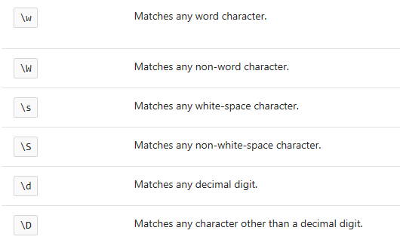
Shorthands
[a-zA-Z0-9_]
[^\w]
[ \t\r\n\f]
[^\s]
[0-9]
[^\d]

Slide 8
Quantifiers
* Matches the previous element zero or more times.
+ Matches the previous element one or more times.
? Matches the previous element zero or one time.
*?, +?, *? Same as above, but as few times as possible
{n} Match exactly n times
{n,} Match at least n times
{n,m} Match between n and m times
Notes:
Match a[a-z]+ agains
axb bxa axe abc

Slide 9
Character sets subtraction
Character sets can be subtracted
Eg: [a-z-[aeiou]] → any consonant
Negation precedes subtraction
[^1234-[3456]] → [7890]

Slide 10
Alternation
Match one of several options
th(e|is|at) ➔ (the|this|that)

Slide 11
Anchors
\b match must be word beginning
\B match not be word beginning
^ match must be line beginning

Slide 12
Group
Aka subexpression
(\w+)\s(\w*)\s*(\w+)\W
Ex:
write a regex to extract different parts of a full name
Notes:
^(?<ho>\w+)\s*(?<dem>\w*\s*)*?(?<ten>\w+)$
Extract Ho, Dem, Ten

Slide 13
^(?<ho>\w+)\s*(?<dem>\w*\s*)*?(?<ten>\w+)$

Slide 14
Performance tuning
Regex are slow!
Cost to create the regex object
Evaluation time is high
Create regex as instance variable.
Consider RegexOptions.Compiled flag.
Try reusing regex object as much as possible.

Slide 15
Topic for next class
Collections

